Slide 1
Diyala University
College of Engineering
Department of Civil Engineering
Water Resources Engineering
for 4th Class
By
Dr. Saad Shauket Sammen

Slide 2
Consumptive use or Evapotranspiration (E.T)
Can be define as the total amount of water which used by the plant in transpiration and evaporation from soil surface and plant leaves in any specified period. The values of the consumptive use may be different for different crops and may be different for the same crop but at different times and places. It measured by (mm/day or mm/month).
Consumptive use is depended on three factors:-
1- Climatic condition.
2- Soil factors
3- Plant factors.
Some Important Definitions
Effective rainfall:
Precipitation falling during the growing period of a crop that is available to meet the evapotranspiration needs of the crop is called effective rainfall. It is that part of rainfall which is available to meet ET needs of the crop
Re = R – Rr – Dr
Where, R = Precipitation
Rr = Surface runoff
Dr = Deep percolation

Slide 3
Consumptive Irrigation Requirement (CIR):
Irrigation water required in order to meet the evapotranspiration needs of the crop during its full growth
CIR = (Cu) - (Re)
Net Irrigation Requirement (NIR):
It is the amount of irrigation water required in order to meet the evapo-transpiration need of the crop as well as the other needs.
NIR = (Cu) - (Re) + Water lost as percolation
Field Irrigation Requirement (FIR):
It is the amount of water required to be applied to the field
FIR = NIR + water application losses

Slide 4
Gross Irrigation Requirement (GIR):
It is the amount of water required at the head of a canal
GIR = FIR + conveyance loss
Estimation of Consumptive use or Evapotranspiration
Consumptive use can be directly measured by:-
1.Tank and lysimeter.
2.Soil moisture depletion.
3.Inflow and outflow for large areas.
4.Energy balance and heat measure transfer.
Various empirical methods have have been developed to estimate the consumptive use value, the commonly methods used are:-

Slide 5
Blaney – Griddle Formula :-
In this method the monthly consumptive use can be estimate by the following equation :
E.T = 0.045 K.P (T + 17.8)
Where: E.T: Monthly consumptive use in (cm)
K: crop factor can be founded as K = Kt . Kc
Kt: depended on average temp. during the month and can be founded by:
Kt = 0.2396 + 0.03114 T
Kc: is a coefficient which depended on type of crop and degree of growth, can be founded from (Table 1)
P: Monthly percentage of annual day light hours (Table 2).
T: Average monthly temperature in degree centigrade (Cº)

Slide 6
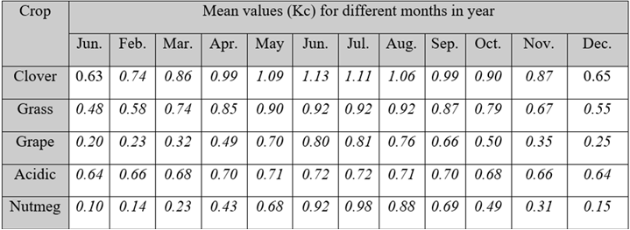
Table 1 Values of (Kc) according to plant type and degree of growth
A) Perennial crops

Slide 7
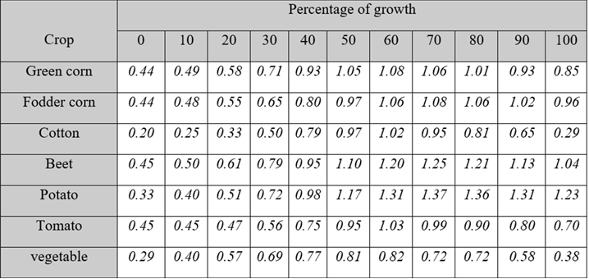
B) Seasonal crops

Slide 8
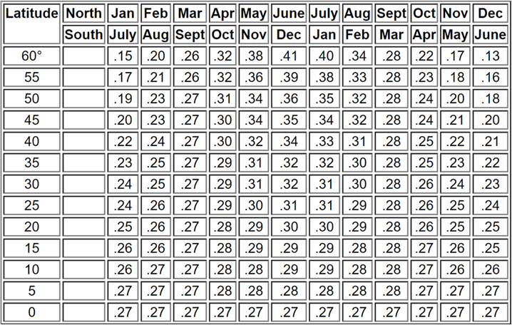
Table 2 Mean daily percentage of annual hours for different latitudes

